Slide 1
Introduction to Virtual Reality Toolbox
Concordia University
Department of Computer Science and Software Engineering
SOEN385
Control Systems and Applications

Slide 2
What Is the Virtual Reality Toolbox?
The Virtual Reality Toolbox is a solution for interacting with virtual reality models of dynamic systems over time.
Extends the capabilities of MATLAB and Simulink into the world of virtual reality graphics:
  Virtual Worlds
    Create virtual worlds or 3D scenes using standard Virtual Reality Modeling Language (VRML) technology.
  Dynamic Systems
    Create and define dynamic systems with MATLAB and Simulink.
  Animation
    View moving 3D scenes driven by signals from the Simulink environment.
  Manipulation
    Change the positions and properties of objects in a virtual world while running a simulation.

Slide 3
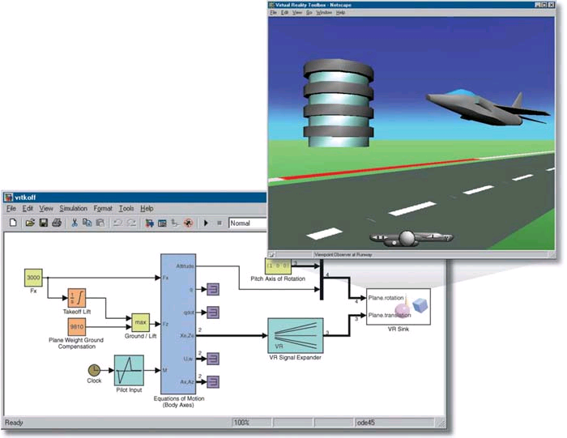
Virtual Reality Toolbox

Slide 4
Virtual Reality Toolbox
Features:
  VRML Support
    Use VRML to define a virtual world
  MATLAB Interface
    Control the virtual world from the MATLAB interface
  Simulink Interface
    Use VR Toolbox blocks to connect your Simulink model to a virtual world
  MATLAB Compiler Support
    Generate redistributable, stand-alone applications that include VR Toolbox functionality, including the VR Toolbox viewer
  Client-Server Architecture, Hardware Support, …

Slide 5
Virtual Reality Toolbox
Additional Components:
  VRML Viewer
    Use either the VR Toolbox viewer or a plug-in for Web browsers to display your virtual worlds.
  VRML Editor
    For Windows platforms, use V-Realm Builder to create and edit VRML code.
    For UNIX or Linux platforms, use the MATLAB text editor to write VRML code to create virtual worlds.

Slide 6
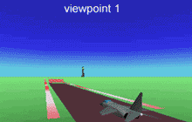
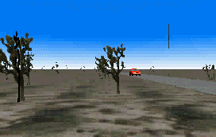
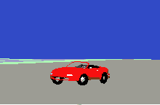
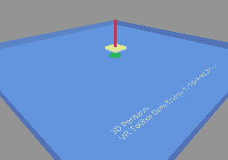
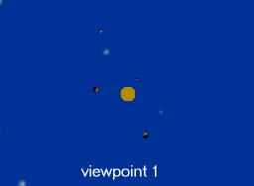
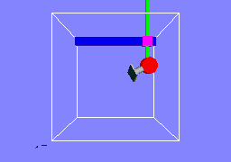
Virtual Reality Toolbox
Demos
www.mathworks.com/products/virtualreality/demos.html

Slide 7
Simulink Interface
With a Simulink model, you can observe a simulation of your dynamic system over time in a visually realistic 3D model.
The VR Toolbox provides blocks to directly connect Simulink signals with virtual worlds. This connection lets you visualize your model as a 3D animation.
The VR Toolbox automatically scans a virtual world for available VRML nodes that Simulink can drive.

Slide 8
Simulink Interface
Steps to make it work:
  Create the simulation model of the system dynamics
  Create the associated virtual world
  Insert VR block(s) into the Simulink model
  In VR block parameters, select the virtual world and its degrees of freedom to be accessed from Simulink
  Connect the VR block inputs/outputs to corresponding signals in the model
  Display the virtual world in a viewer
  Run the simulation

Slide 9
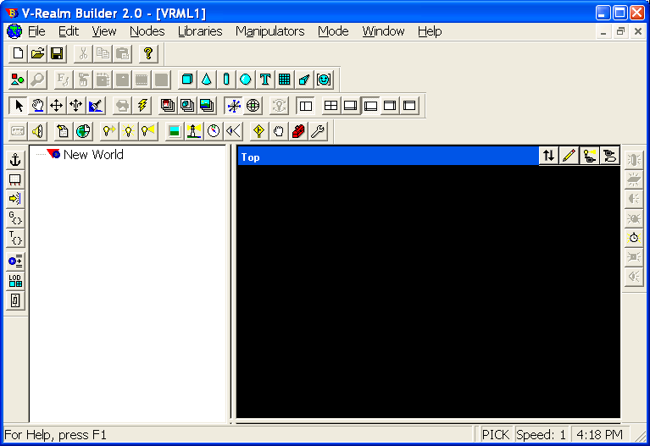
V-Realm Builder
A flexible, graphically oriented tool for 3D editing
A VRML authoring tool that provides a convenient interface to the VRML syntax
Run the executable
matlabroot\toolbox\vr\vrealm\program\vrbuild2.exe
View Pane
Node Tree
Window

Slide 10
Simulink Interface Example
Simulate and visualize in VR the movement of a ball:
  Start by clicking on the New Document button
  Click on the Insert Background button to add sky and ground to your world
  Click on the Insert Sphere icon
    Note that the Node Tree Window is updated with the group representing the sphere and its possible properties
  Drag and drop the sphere to the lower left of the View Pane
    Translate to [-4 -1 0]
  Make the sphere smaller
    Set the radius to 0.5

Slide 11
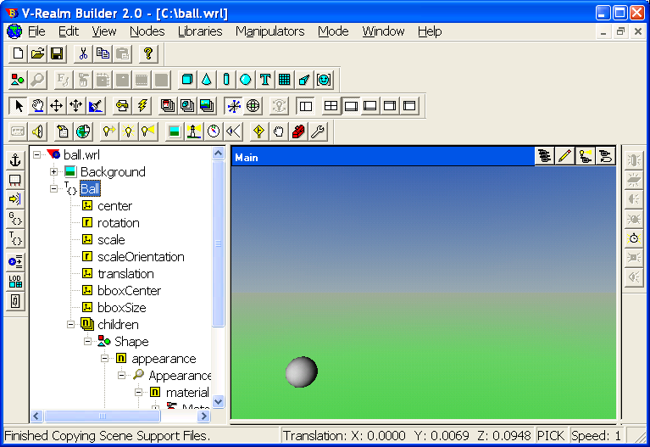
Simulink Interface Example
In VRML, you have to name your objects to be able to create interactions later on!
  In the Node Tree, select the top level of the sphere group, then click on the word Transform and change it to Ball
Save your file with the name ball.wrl

Slide 12
Simulink Interface Example
Create a new Simulink model and insert a VR Sink block from the Virtual Reality Toolbox library.
In the Simulink window, double-click the VR Sink block.
Click Browse. The Select World dialog box opens. Select ball.wrl, and then click Open.
In the Output pane, select the Open VRML viewer automatically check box.
In the Description field, type moving ball.
In the tree viewer, select the Ball translation check box as the nodes you want to connect to your model signals.
Click OK to close the dialog box.

Slide 13
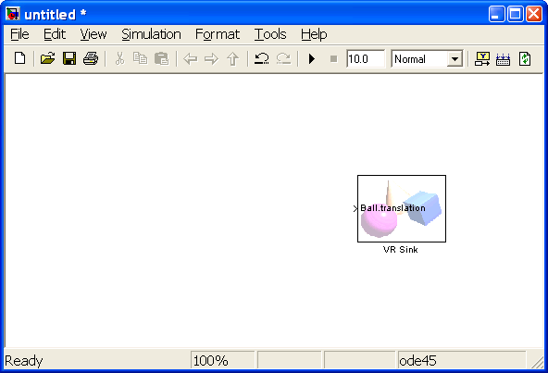
Simulink Interface Example
The Virtual Reality Toolbox block appears with corresponding input:

Slide 14
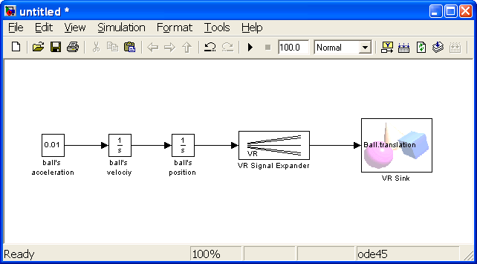
Simulink Interface Example
Create a simple model to generates the signals for the ball’s position.
Connect the VR block input to corresponding signals in the model.
Change the parameters of VR Signal Expander appropriately!

Slide 15
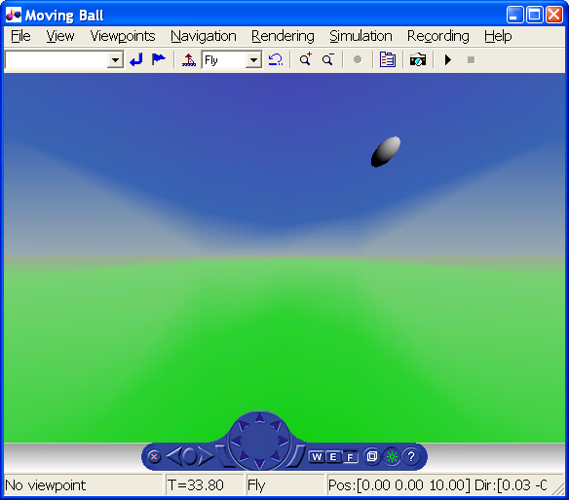
Simulink Interface Example
Double click the VR Sink block to open the VRML viewer
Click the Start Simulation button

Slide 16
References
MATLAB SIMULINK
Virtual Reality Toolbox User's Guide
www.mathworks.com/access/helpdesk/help/pdf_doc/vr/vr.pdf
V·Realm™ Builder
User's Guide and Reference
www.cs.vu.nl/~eliens/documents/vrml/V-Realm

